Slide 1
Sampling Methods for Extremely Imbalanced Data
Chris Kuo, Ph.D.| Columbia University

Slide 2
What is imbalanced data?
Statement of the problem
Notes:
This is the question that your experiment answers

Slide 3
Imbalanced data
A dataset is imbalanced if at least one of the classes constitutes only a very small minority.
Imbalanced data prevail in banking, insurance, engineering and many other fields.
It is common in fraud detection that the imbalance is on the order of 100 to 1.

Slide 4
The Receiver operating characteristic (ROC) curve
Consider an insurance company who needs to know a claim is fraudulent or not. The company needs to predict claims that may be fraudulent and take steps to prevent.
Suppose 1% of 10,000 claims are fraudulent. If the data scientist predicts that ALL claims are not fraudulent, he gets 99% accuracy in the ROC curve. However, the data scientist totally missed the 1% true fraudulent claims.
The ROC curve does not measure well for imbalanced data.

Slide 5
The Receiver operating characteristic (ROC) curve
 | Actual positive | Actual negative
Predicted positive | TP | FP
Predicted negative | FN | TN
Name | Metric
True Positive Rate (TPR) | TP/(TP+FN)
False Positive Rate (FPR) | FP/(FP+TN)
Recall | TP/(TP+FN)
Precision | TP/(TP+FP)
FPR =1-TNR

Slide 6
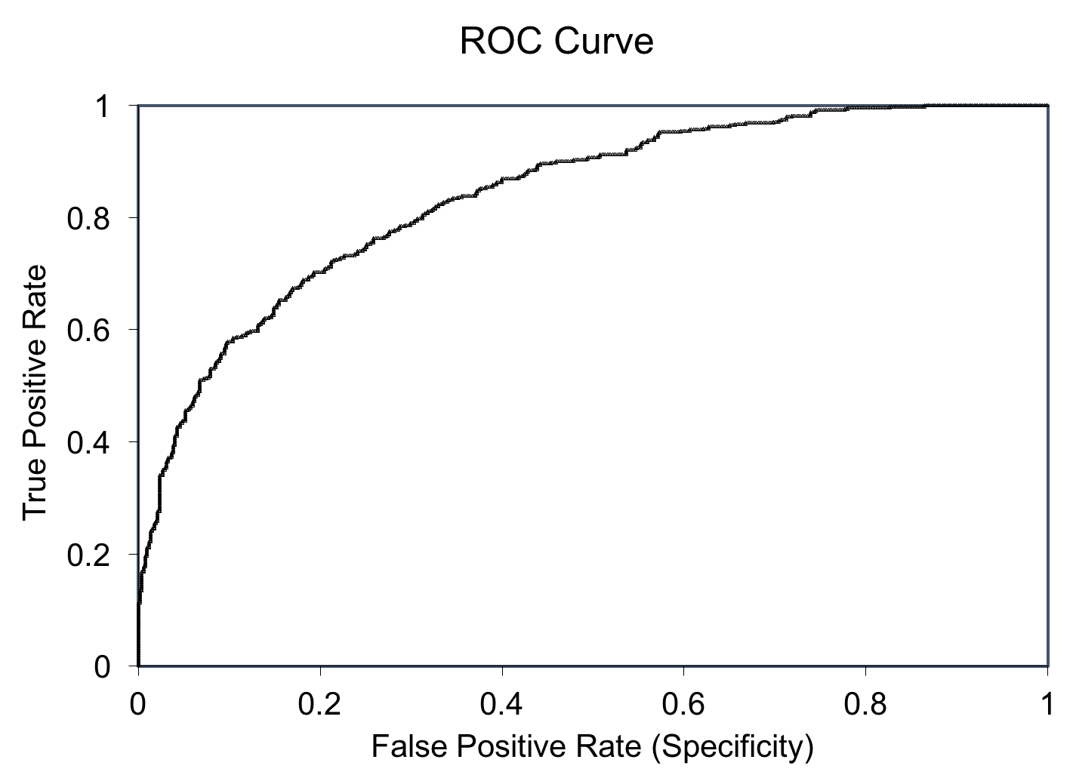
The Receiver operating characteristic (ROC) curve
TP/(TP+FN)
Sensitivity
FP/(FP+TN)
Specificity

Slide 7
Area Under the (ROC) Curve, AUC
AUC=1.0
AUC=.80
AUC=.50
Sensitivity
Specificity

Slide 8
Why can’t an ROC curve measure well?
Statement of the problem
Notes:
This is the question that your experiment answers

Slide 9
The Receiver operating characteristic (ROC) curve
Because TPR only depends on positives, ROC curves do not measure the effects of negatives.
The area under the curve (AUC) assesses overall classification performance. AUC does not place more emphasis on one class over the other, so it does not reflect the minority class well.
TP/(TP+FN)
FP/(FP+TN)

Slide 10
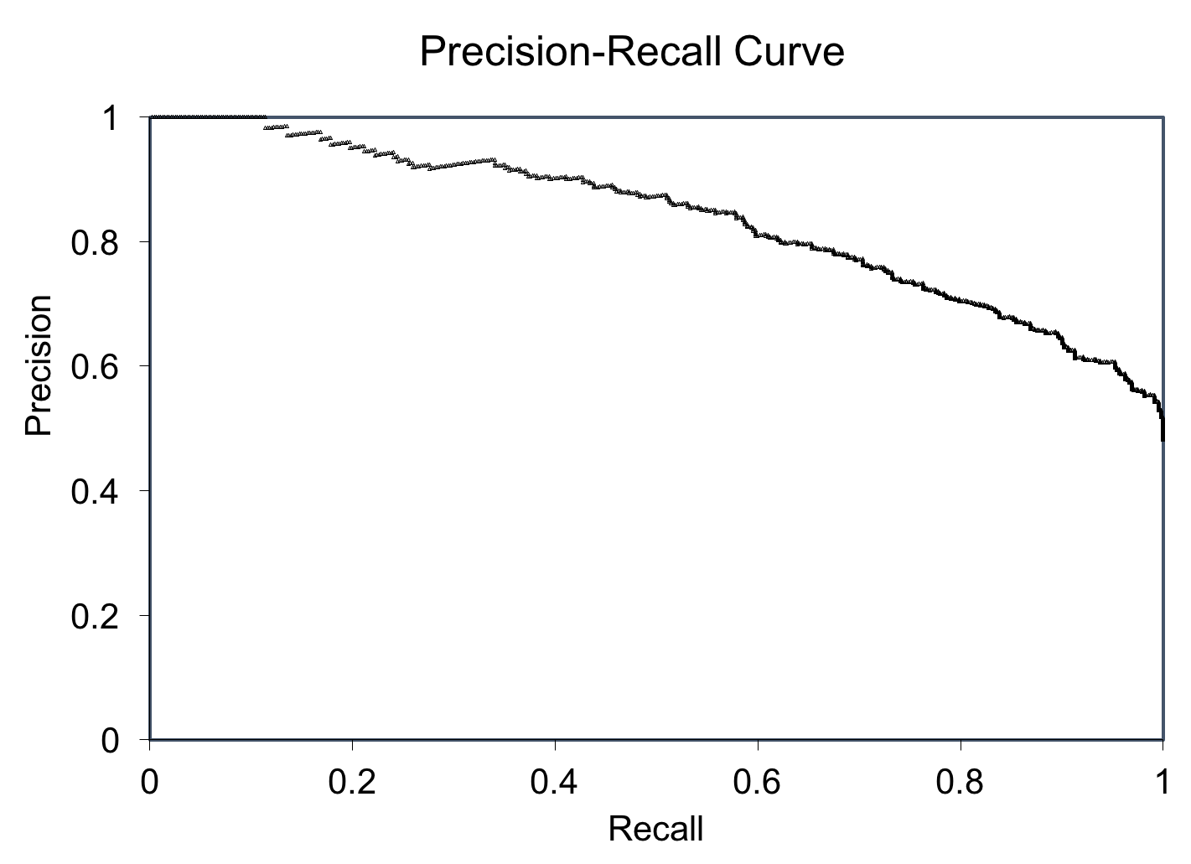
Should use the Precision-Recall curve
The Precision is directly influenced by class imbalance so the Precision-recall curves are better to highlight differences between models for highly imbalanced data sets.
By Davis and Goadrish in a well-cited paper.
TP/(TP+FP)
TP/(TP+FN)

Slide 11
Q. What are the remedies?
Statement of the problem
Notes:
This is the question that your experiment answers

Slide 12
Under-sampling
Random sample
Condensed Nearest Neighbor Rule (CNN)
Over-sampling
Random sample
Synthetic Minority Oversampling Technique (SMOTE)
Edited Nearest Neighbor Rule (ENN)
TomekLinks
One-sided selection
Neighborhood Cleaning Rule
ADASYN: Adaptive Synthetic Sampling¶
Notes:
Summarize your research in three to five points.

Slide 13
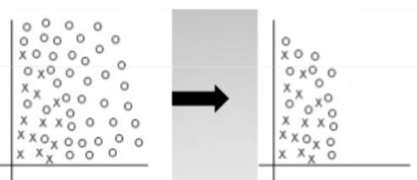
Condensed Nearest Neighbor Rule (CNN)
The idea is to remove the points in the majority class that are far from the decision border.
Notes:
Summarize your research in three to five points.

Slide 14
Edited Nearest Neighbor Rule (ENN)
Each point is removed if it does not agree with the majority of its k nearest neighbors (with k=3, typically).
The algorithm edits out noisy points and close border cases, leaving smoother decision boundaries. It also retains all internal points. So it yields a stabilized result when there are increasing noises.
Removed
Notes:
Summarize your research in three to five points.

Slide 15
Tomek Links (1976)
(1976) proposed an effective method that consider samples hear the borderline.
Given two instances a and b belonging to different classes and are separated by a distance d(a,b), the pair (a, b) is called a Tomek link if there is no instance c such that d(a,c) < d(a,b) or d(b,c) < d(a,b). Instances in the Tomek links are either borderline or noise so should be removed.
Notes:
Summarize your research in three to five points.

Slide 16
One-sided selection
Two types of instances are removed:
Borderline examples: close to the boundary between positive and negative regions. These examples are unreliable.
Redundant examples: The examples whose part can be taken over by other examples, which means they can not provide any other useful information.
A combination of Tomek Links and CNN.
Notes:
Summarize your research in three to five points.

Slide 17
Near Miss
Near Miss samples from the majority class for which the average distance to some nearest neighbors is the smallest.
Point A: Avg. distance = 0.96
Point B: Avg. distance = 1.13
So “A” is kept and “B” is dropped.
--- Avg. distance = 0.96
--- Avg. distance = 1.13
Minority class
Majority class
+
B
Drop
A
Keep
Notes:
Summarize your research in three to five points.

Slide 18
Under-sampling
Random sample
Condensed Nearest Neighbor Rule (CNN)
Over-sampling
Random sample
Synthetic Minority Oversampling Technique (SMOTE)
Edited Nearest Neighbor Rule (ENN)
TomekLinks
One-sided selection
Neighborhood Cleaning Rule
ADASYN: Adaptive Synthetic Sampling¶
Notes:
Summarize your research in three to five points.

Slide 19
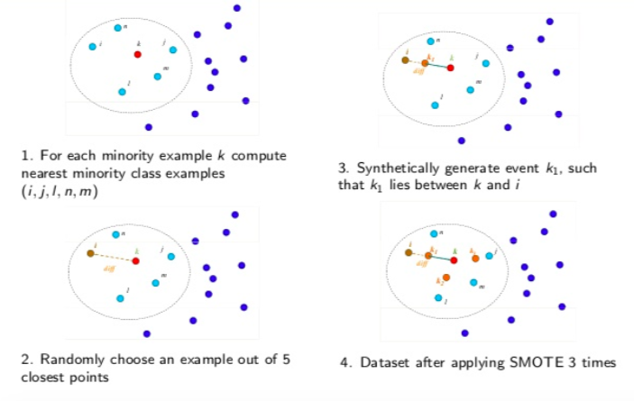
Synthetic Minority Oversampling Technique (SMOTE)
1
2
For each minority instance k, compute the nearest minority class instances (I,j,l,n,m)
Randomly choose an instance out of 5 closest points
Synthetically generate that k1 between k and i
Repeat three times
n
i
k
j
m
l
4
3
k1
Notes:
Summarize your research in three to five points.

Slide 20
ADASYN: Adaptive Synthetic Sampling¶
Motivated by SMOTE, He et al. (2009) propose the Adaptive Synthetic sampleing (ADASYN) technique and receive wide attention.
The essential idea of ADASYN is to use a weighted distribution for different minority class examples according to their level of difficulty in learning, where more synthetic data is generated for minority class examples that are harder to learn compared to those minority examples that are easier to learn.
It calculates the K-nearest neighbors of each minority instance, then gets the class ratio of the minority and majority instances to generate new samples. By repeating this process, it adaptively shifts the decision boundary to focus on those samples that are difficult to learn.
As a result, the ADASYN approach improves learning with respect to the data distributions in two ways: (1) reducing the bias introduced by the class imbalance, and (2) adaptively shifting the classification decision boundary toward the difficult examples.
Notes:
Summarize your research in three to five points.

Slide 21
Work cited
R CRAN

